Slide 1
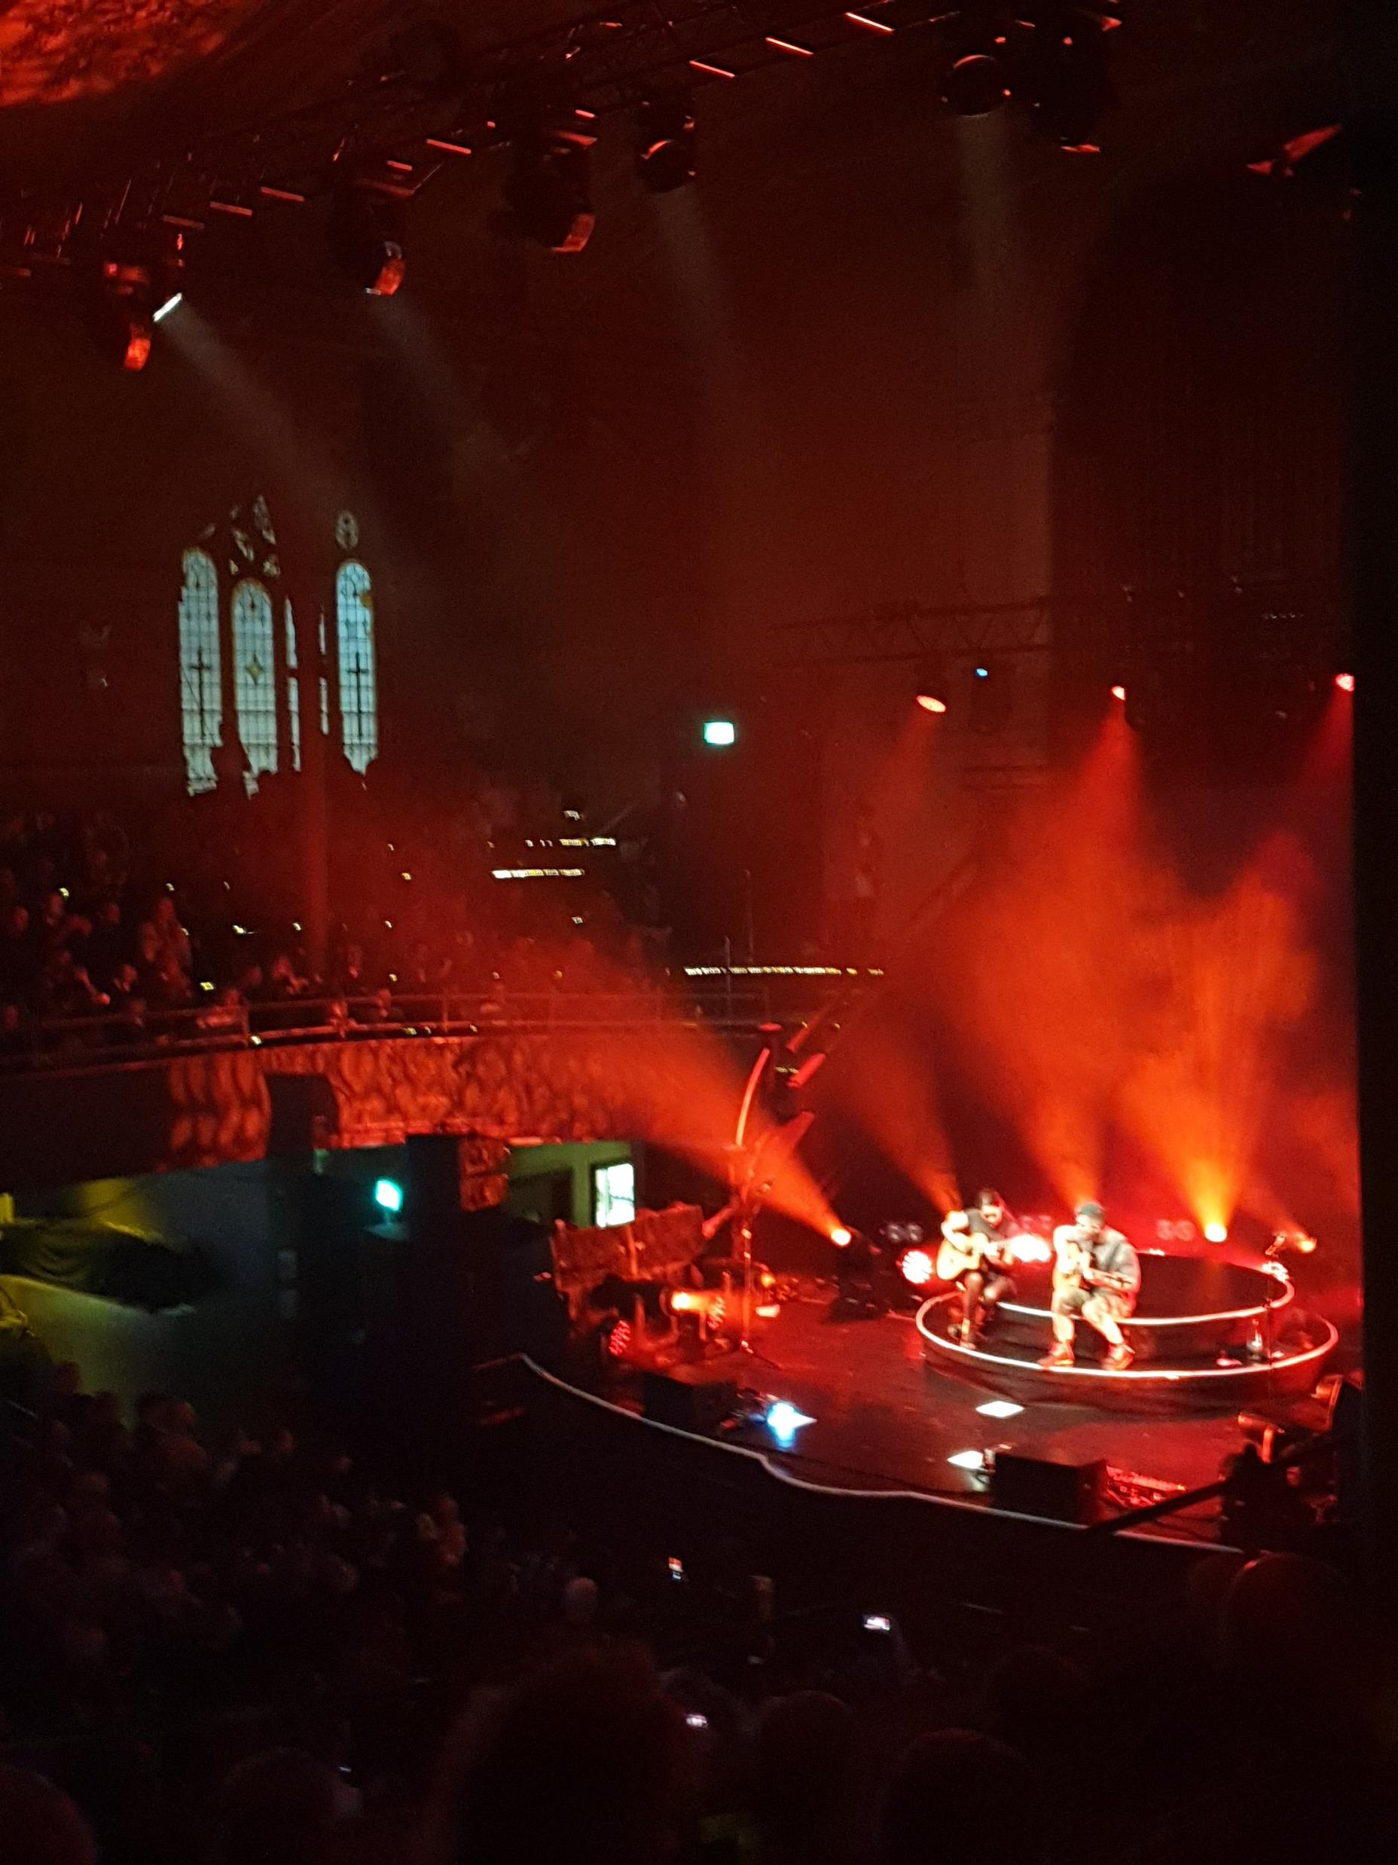
Arts programming: a framework for planning and strategic analysis
Dr Jonathan Price, University of Leeds
Arts in Society conference, Zaragoza, July 2022
j.f.r.price@leeds.ac.uk

Slide 2
Overview
What is arts programming?
Why does it require analysis?
Who’s involved with programming?
What are the criteria for decision making?
Which factors limit possible assessment of programming choices?
What next?

Slide 3
What is arts programming?

Slide 4
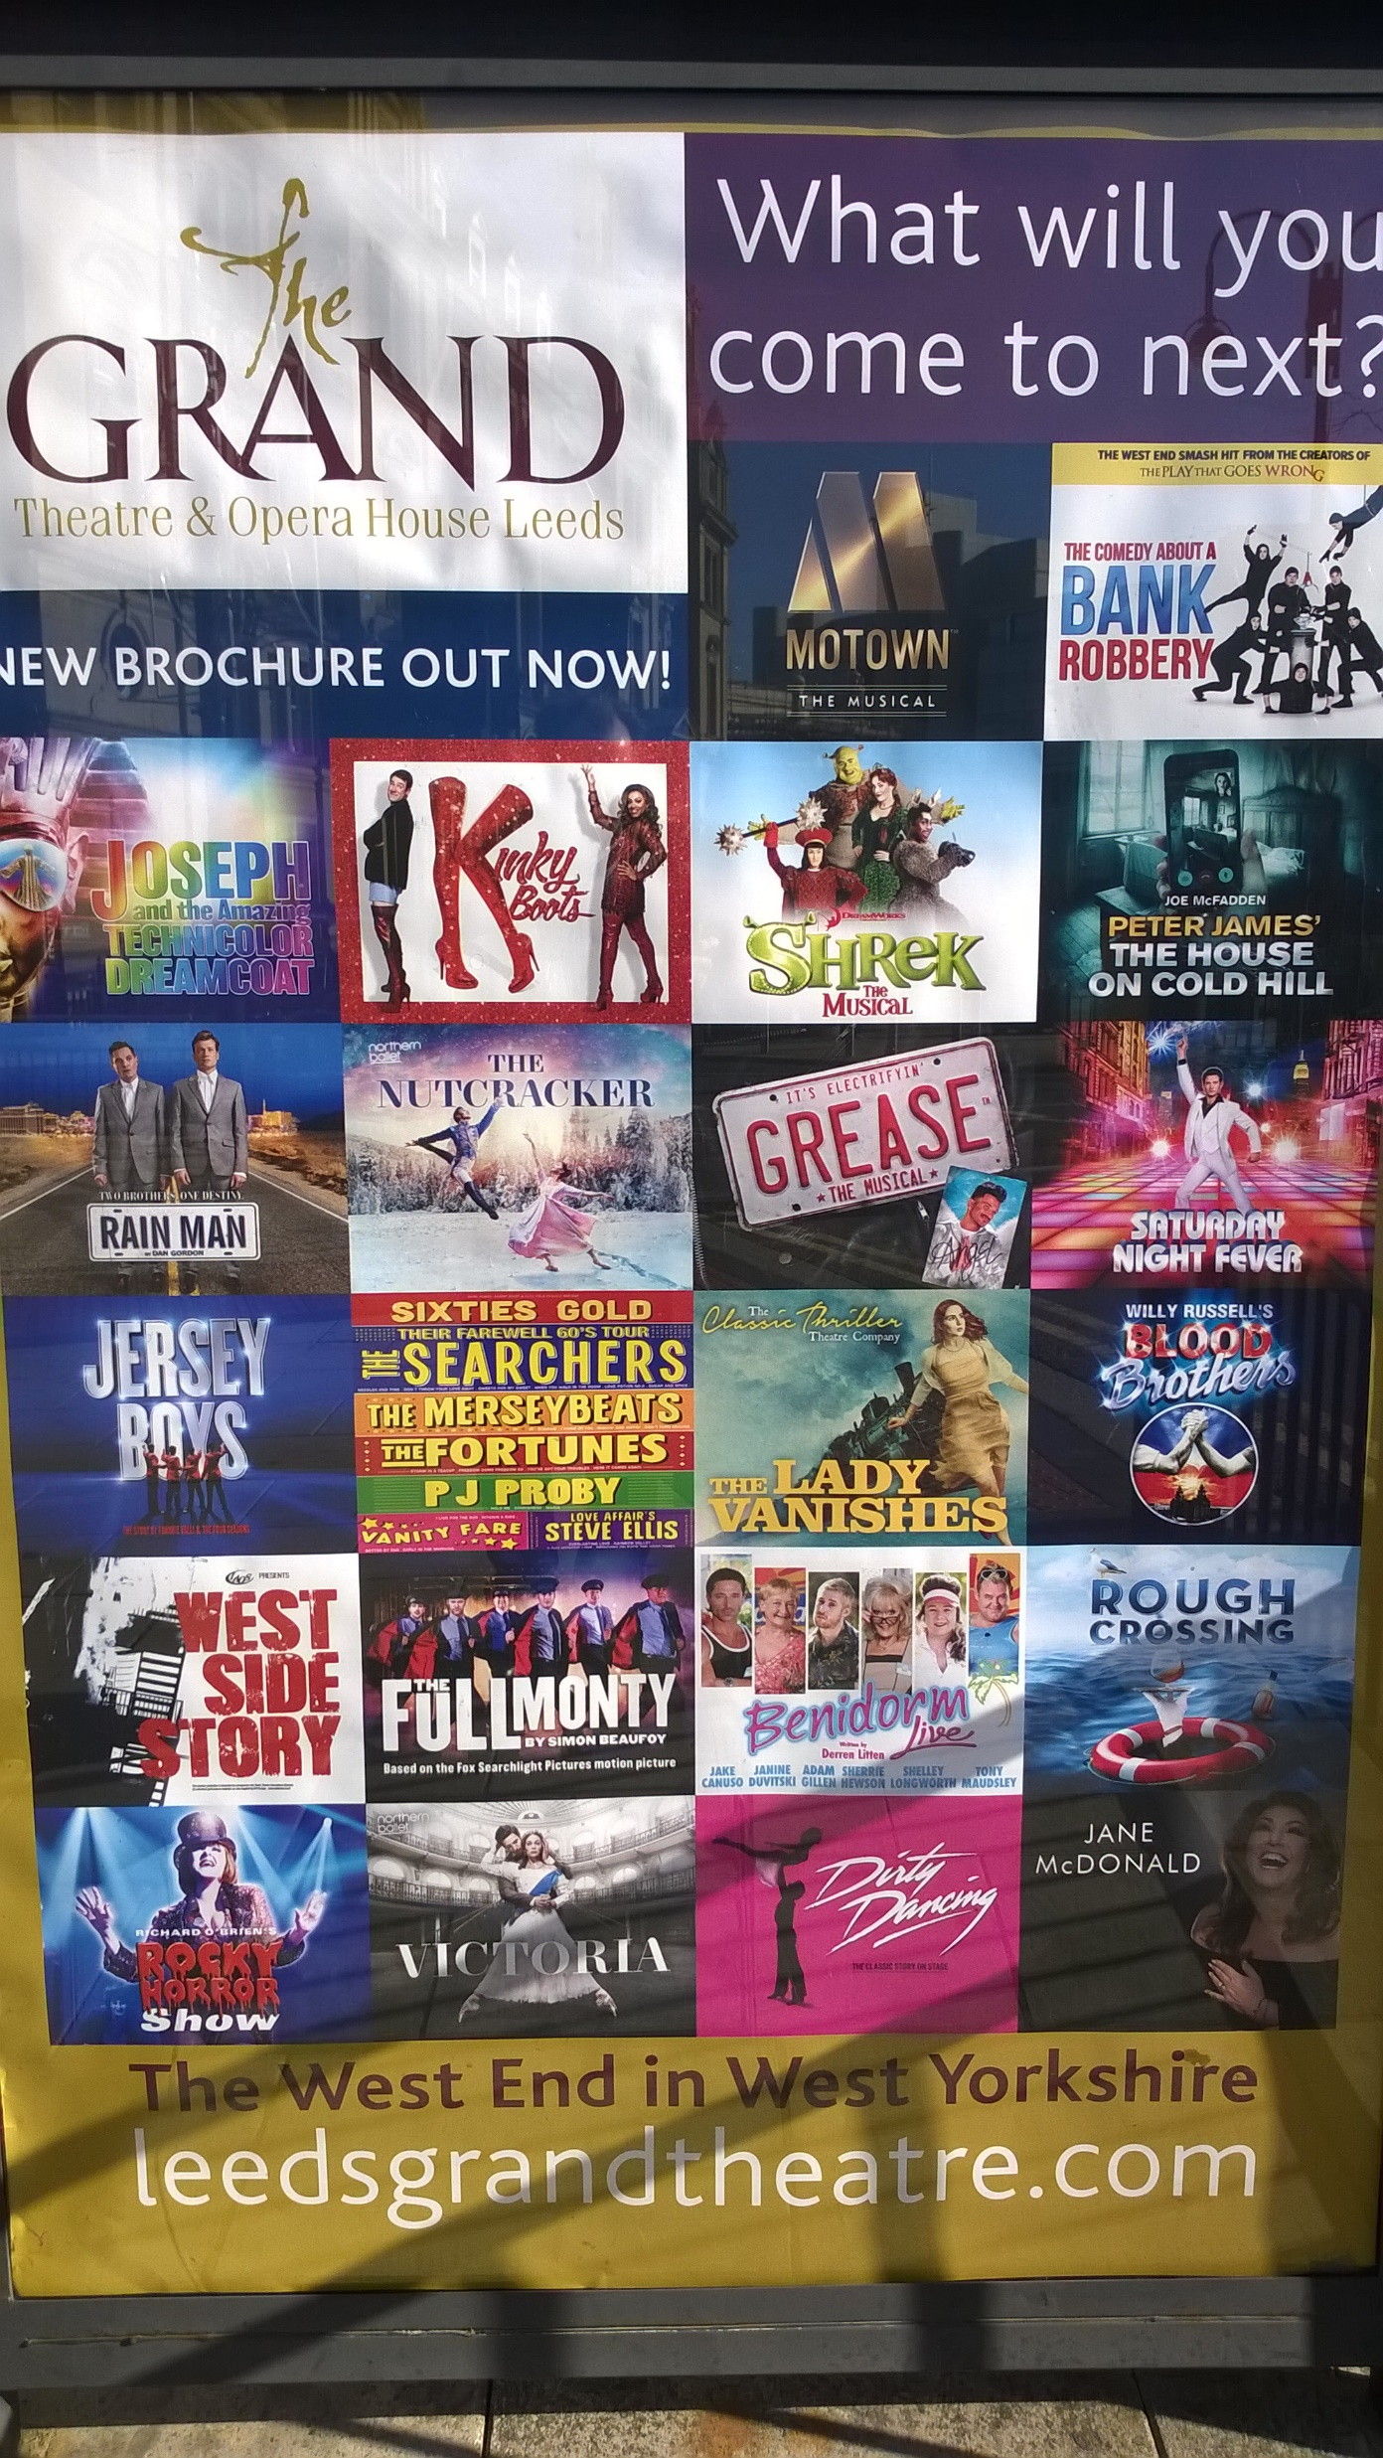
Arts programming is…
“the planning and delivering of arts and cultural leisure experiences for individuals and groups.”
Carpenter & Blandy 2008, p.9
“the distributive phase of cultural products which are consumed at the point of live experience by the attender”
Kawashima 1999: 280

Slide 5
Arts programming is…
“the ‘how do you choose what you book?’ question that non-arts friends and relatives inevitably ask when they find out what you do”
Turpin 2014
\
“A cultural facility’s identity” expressed through the “intentionality and coherence” of the artistic project
Bonet & Schargorodsky 2018: 94-5

Slide 6
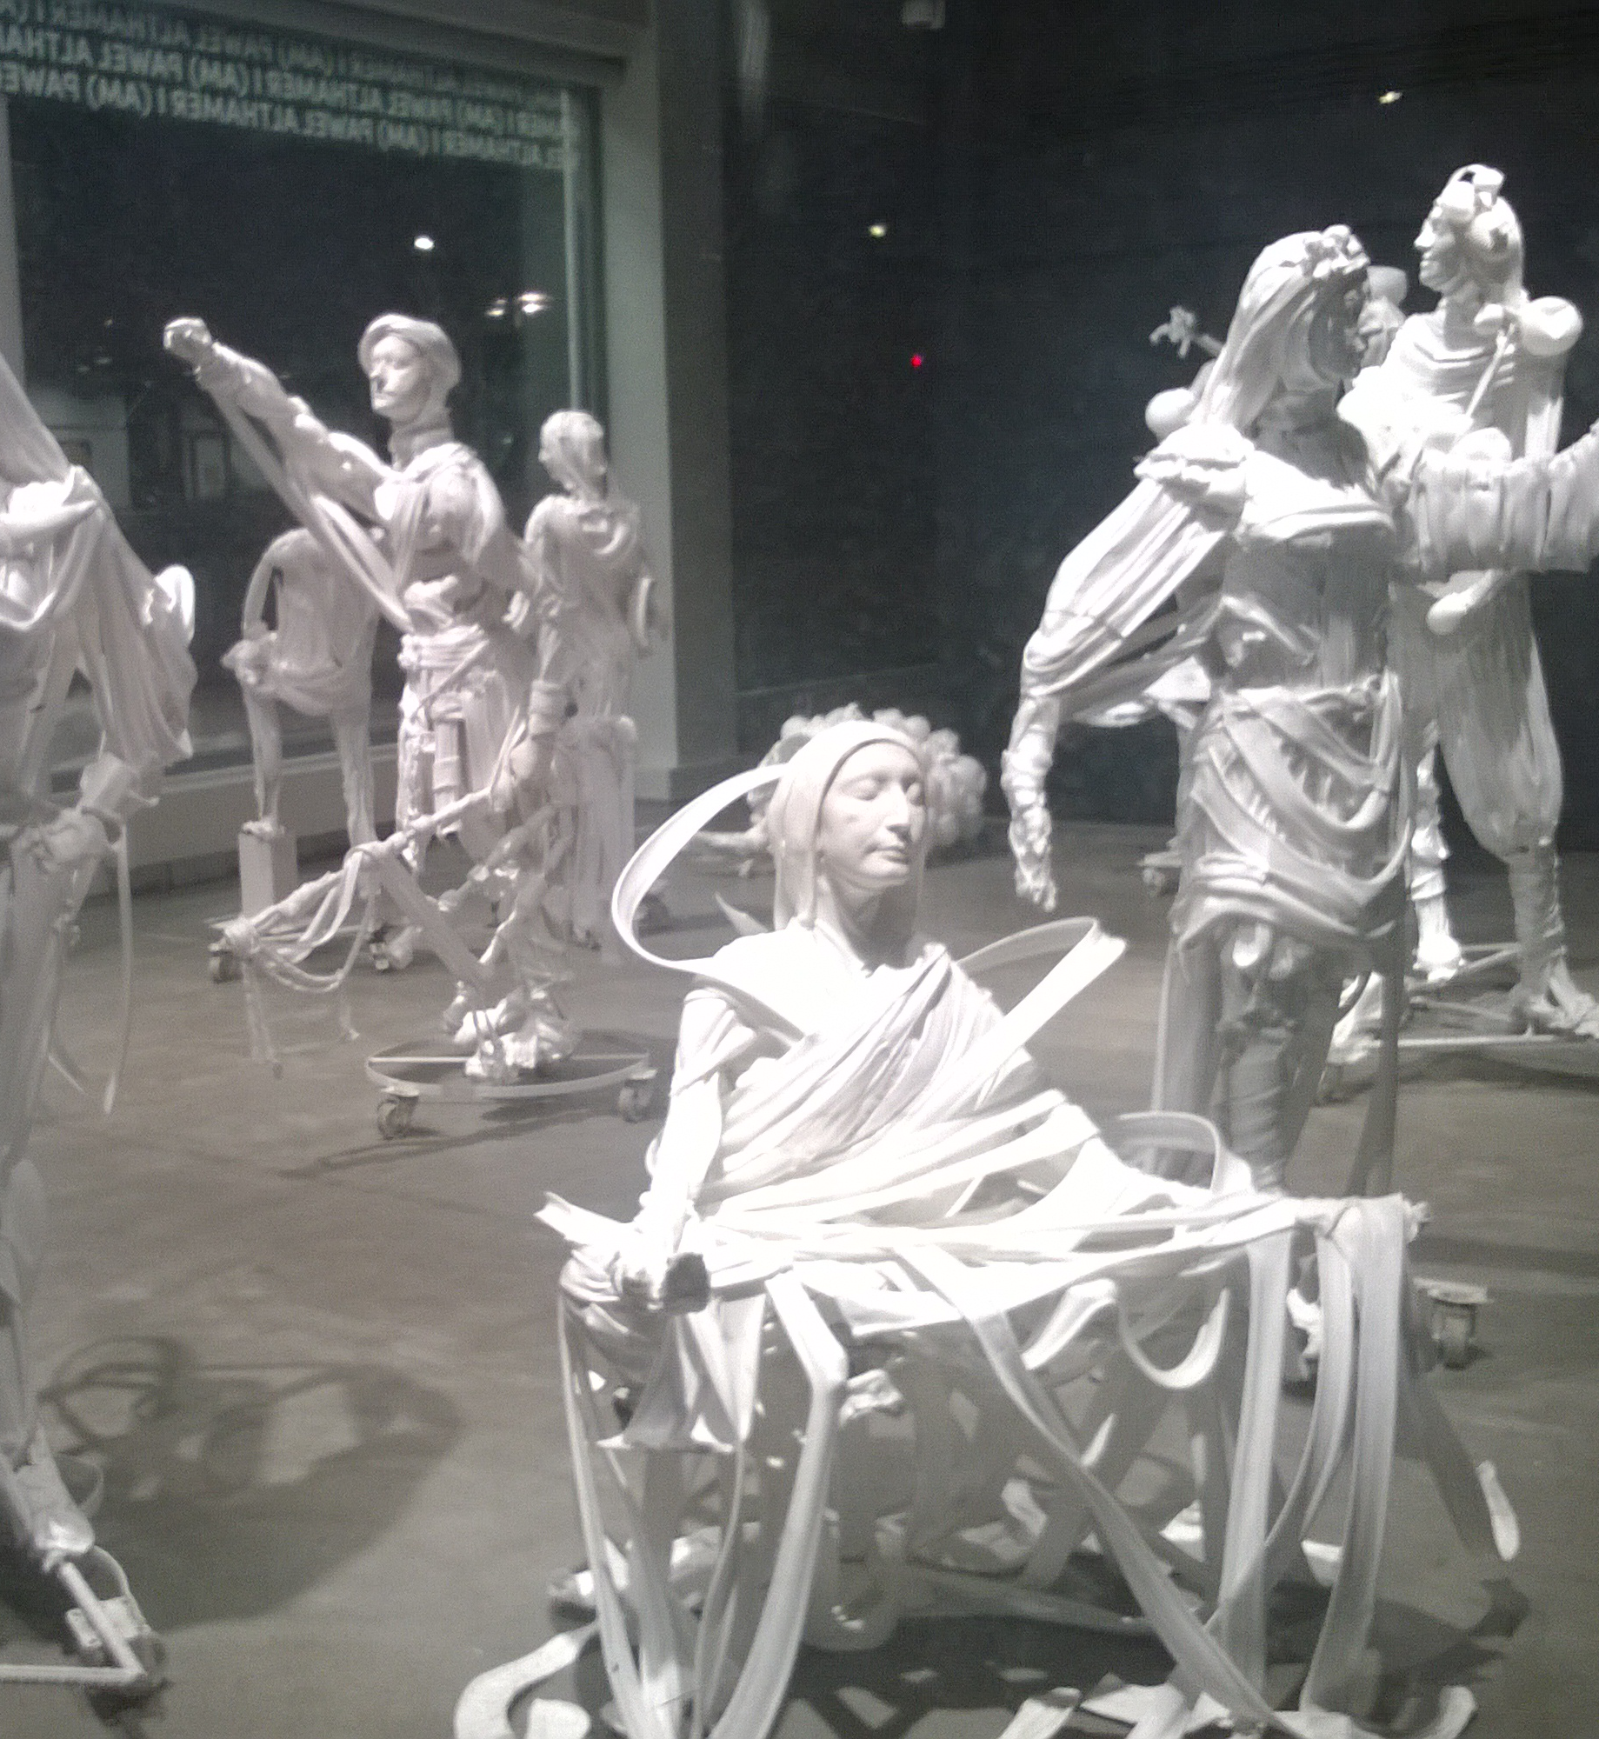
What needs to be programmed?
Activities
  Workshops, classes, education programmes, residencies
Services
  Private/exclusive tours, audio guides, online resources, services enhancing accessibility
Events
  Performances, exhibitions, festivals, launches/openings
  Carpenter & Blandy 2008: 22

Slide 7

Programming models
(performing/experiential arts)
Four basic venue types:
Producing venue (content developed in-house)
Receiving venue (curated programme under venue control)
Mixed mode (combination of in-house and touring/external)
Venue for hire (no distinct programming identity)
(see Bonet & Schargorodsky 2018 pp.51-4 for expanded list)
Two approaches to independent production:
Creative producer seeking traditional arts venues
Creative producer programming in non-standard venues

Slide 8
Why does it require analysis?

Slide 9
Artistic programming
“programmatic ambitions must reflect the organization’s true mission… Very rarely does a significant programmatic shift away from mission result in long-term gains”
Kaiser & Egan 2013: 9-10
Arguably the most mission-critical element in artistic management, with other aspects (marketing, funding, governance, logistics) ultimately at the service of programming – but a topic under-represented in arts management literature.

Slide 10
Who’s involved with programming?

Slide 11

Who programmes?
“Arts organizations are not there simply to fill in slots: they are meant to exist because an artistic leader has something unique and important to express”
Kaiser & Egan 2013: 6
Artistic Director?
External Promoter?
Centralised chain programmer?
Specialist or all-rounder?
Individual, team or community?

Slide 12
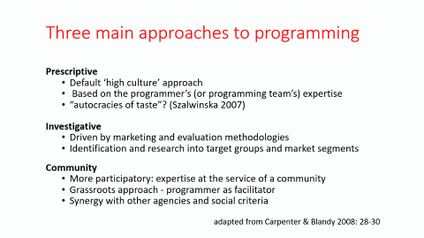
Three main approaches to programming
Prescriptive
  Default ‘high culture’ approach
  Based on the programmer’s (or programming team’s) expertise
  “autocracies of taste”? (Szalwinska 2007)
Investigative
  Driven by marketing and evaluation methodologies
  Identification and research into target groups and market segments
Community
  More participatory: expertise at the service of a community
  Grassroots approach - programmer as facilitator
  Synergy with other agencies and social criteria
  adapted from Carpenter & Blandy 2008: 28-30

Slide 13
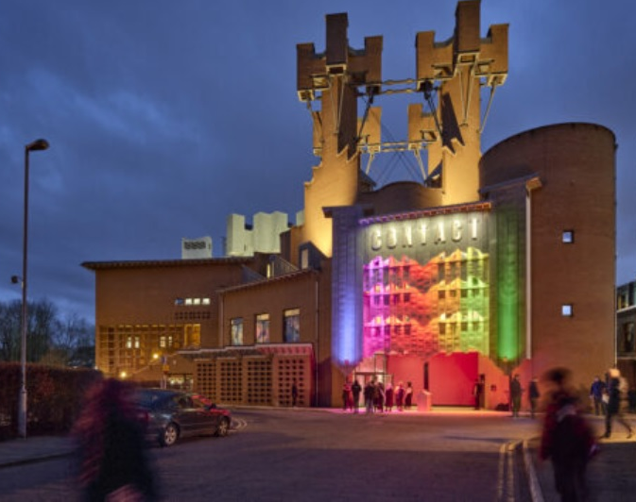
Citizen curators
“a paradigm shift in how cultural leadership is viewed and practiced”
“an instinct that a theatre’s programme and strategic direction could be ‘devised’ collaboratively, rather than visioned from the top...
Inviting local residents to form a programming team … was radical mainly in that they were not engagement projects alongside a professionally curated programme. They were the programme, with full budget, production and marketing weight.”
Matt Fenton (2022)
Contact Theatre, Manchester

Slide 14
Collaboration: sustainable expertise?
“Maintaining a working knowledge, let alone an in-depth one, of so many artforms is a challenge, and in my experience, programming solo is less than satisfactory … increasingly I am not driving the programme in areas that I would consider my areas of expertise – theatre, spoken word, dance – as we move away from buying in finished, touring work, and shift towards a more collaborative model of working with artists and audiences.”
Annabel Turpin (2014), Arc, Stockton

Slide 15
Programmer job description
Using IT packages such as spreadsheets and databases as well as specialist events IT software to schedule the programme of events
Liaising with agents to hold dates and venues for events to take place
Providing administrative support to the venue programme manager, including lots of telephone work and email
Issuing and chasing the return of contracts
Liaising with agents to obtain brochure copy and images to pass on to the marketing department
Preparing all the planning documentation
Assisting the programming manager with artist and programme research/reporting.
Creative Choices, 2017

Slide 16
What are the criteria for decision making?

Slide 17
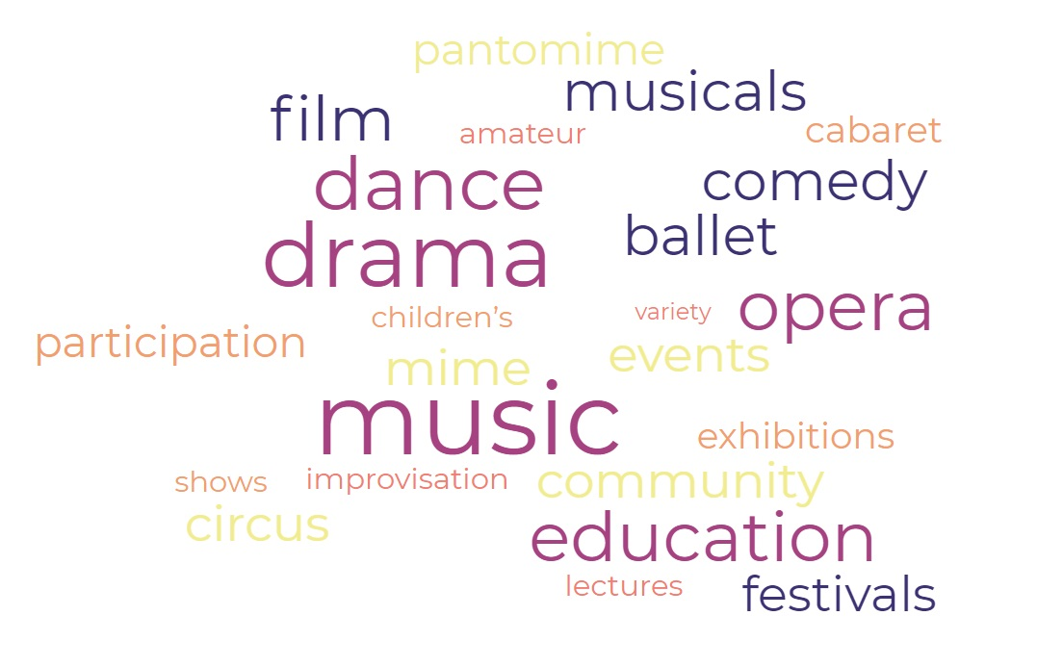
The programme ‘mix’: what are you known for?

Slide 18

The programme ‘mix’: how specialised are you?

Slide 19

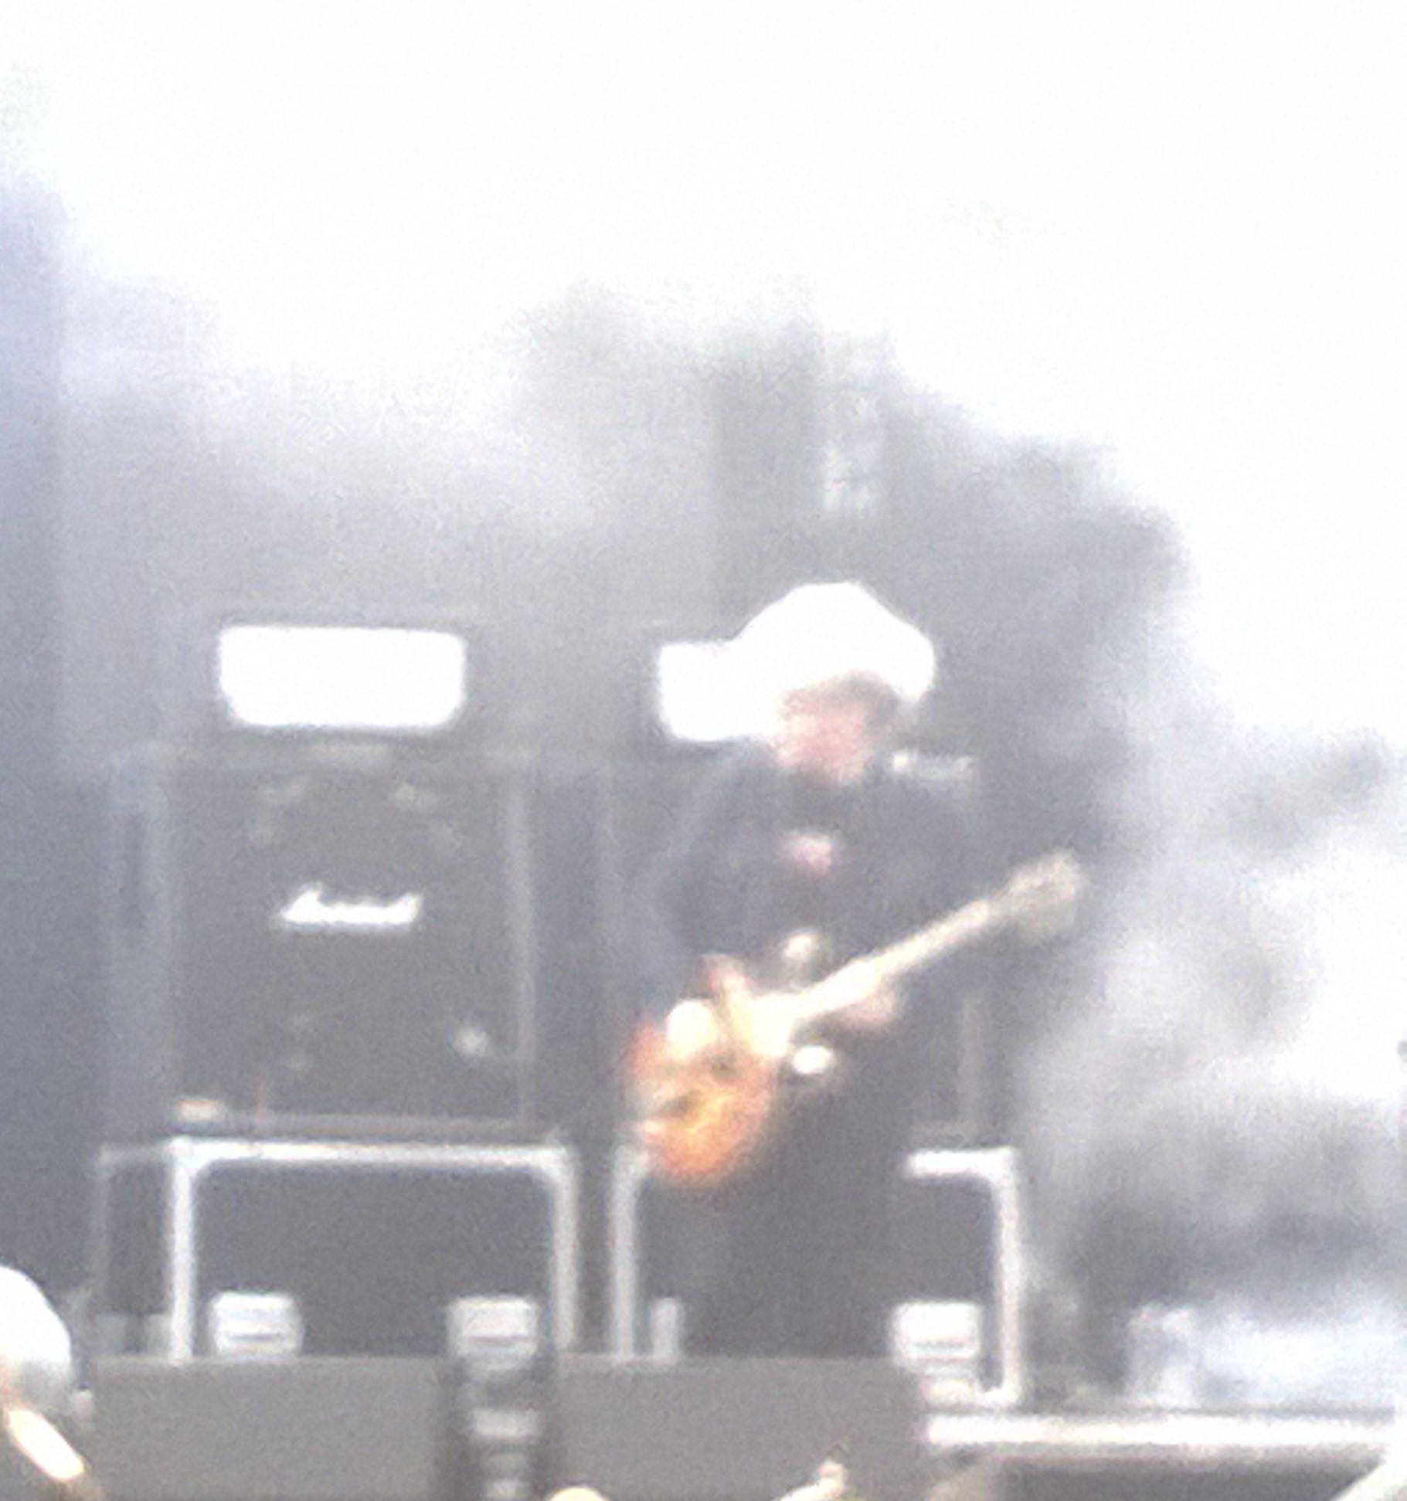
Venue identity
“We handpick our shows and make sure that the programme reflects what we want to say as a venue. I want it to be an environment where people can be inspired by music. […] We have people that come from across the country, from Europe and even from across the Atlantic, because they’ve heard of what we do. I think we’ve always wanted to be more than just a music venue; we’ve always wanted to […] put on culturally important activities.”
Music Venues Trust 2015: 20

Slide 20
Vectors for analysis of programme content
Venue type, scale and location
Vision and mission
Economic model
Timescales (planning and delivery)
Programming mix and conventionality
Blend of activities, services and events
Relationship to existing/intended audiences
Process and decision making

Slide 21
Which factors limit assessment of programming choices?

Slide 22
Contradictions and tensions
Measuring and combining criteria is far from straightforward:
  O’Hagan & Neligan (2005) on repertoire conventionality (limitations of available data and necessary omissions)
  del Mar Casanovas-Rubio et al. (2020) on multi-criteria decision making (MDCM) (a priori requirement for knowing how to weight the different criteria – i.e. there is no methodological substitute for the venue manager’s professional expertise)
Key drivers are frequently in conflict:
  Artistic vision/audience taste/economic model
Mission should be ‘revealed’ through the artistic plan over time (Kaiser & Egan 2013: 23) – if not, either the plan or goals are wrong

Slide 23
What next?

Slide 24

More research needed…
To identify different programming models currently being employed in practice
To test the conceptual coherence of the proposed criteria with programmers and other venue stakeholders
To develop a consistent methodology for applying the vectors comparatively to assess effectiveness of planning against vision and mission
To establish applicability across sub-sectors and identify any missing variables

Slide 25
References
Bonet, Lluis and Hector Schargorodsky, 2018. Theatre management: models and strategies for cultural venues. Elverum: Kunnskapsverket.
Carpenter, G. & Blandy, D., 2008. Arts and cultural programming: a leisure perspective. Champaign, IL: Human Kinetics.
Creative Choices, 2017. Venue Programming Assistant https://ccskills.org.uk/careers/advice/article/venue-programming-assistant
Del Mar Casanovas-Rubio, Maria, Carolina Christen, Luz Maria Valarezo, Jaume Bofill, Nela Filimon and Jaume Armengou, 2020. Decision-making tool for enhancing the sustainable management of cultural institutions: season content programming at Palau de la Musica Catalana. Sustainability 12 (14), 5785.
Fenton, Matt, 2022. “Citizen curators at the helm”. Arts Professional, 29th June. https://www.artsprofessional.co.uk/magazine/article/citizen-curators-helm
Kaiser, Michael & Brad Egan, 2013. The Cycle: a practical approach to managing arts organizations. Brandeis University Press.
Kawashima, Nobuko, 1999. Distribution of the arts: British arts centres as ‘gatekeepers’ in intersecting cultural production systems. Poetics 26, 263-283.
Music Venue Trust, 2015. Understanding Small Music Venues: A Report by the Music Venue Trust. Available at: https://www.musiciansunion.org.uk/Files/Reports/Industry/Understanding-Small-Music-Venues
O’Hagan, John and Adriana Neligan, 2005. State subsidies and repertoire conventionality in the non-profit English theatre sector: An econometric analysis. Journal of Cultural Economics, 29(1), pp.35-57.
Sorjonen, Hilppa., 2011. The manifestation of market orientation and its antecedents in the program planning of arts organizations. International journal of arts management, 14(1), p.4.
Szalwinska, Maxie, 2007. ‘Should artistic directors stop programming theatres?’ The Guardian. https://www.theguardian.com/stage/theatreblog/2007/nov/07/shouldartisicdirectorsstop
Turpin, Annabel, 2014. The art of programming. https://futureartscentres.org.uk/the-art-of-programming/
Notes:
Conventionality = It is the average number of theatres in which each play or playwright produced by a given theatre was produced elsewhere in a given period. (p.36)

