Slide 1

The Dream of a Bridge
Between East and West

Slide 2
We are tiny pieces of light, love, and history.
We are stars
interconnected by
magic, music, and words.
Notes:
The past teaches us about the Present!

Slide 3
CARL YOUNG
Human beings are the same
all over the world,
except in their
religion, language, tradition, and culture
Man and His Symbols

Slide 4
Why Past is Important
It provides the foundation
for understanding the present
Key Points:
— Understanding our present world
— Identify the formation of our personal and collective identities
— Appreciation Progress
— Critical thinking skills
— Empathy and Prospective
However, it’s crucial to remember
the past should not be used to justify current prejudices
or to simply repeat past mistakes;
instead, we should actively learn from it
to create a better future.

Slide 5

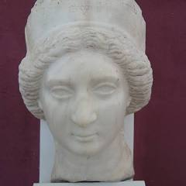
THEA MOUSA
The Parthian Queen
20 BCE-4 CE
Dr. Nooshie Motaref
Notes:
These three books show the evolution of my mind.
Through my writings, I try to bring East and West together and understand the reason it’s so difficult to come together peacefully.

Slide 6
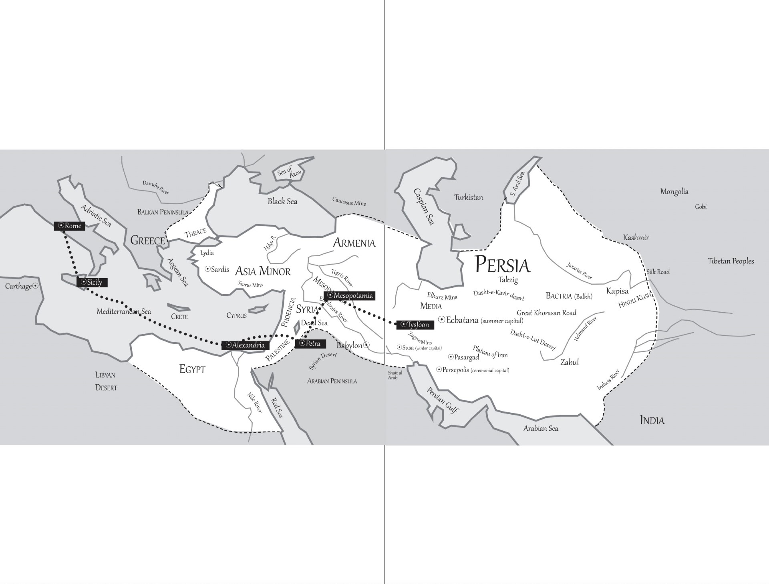
2 SUPERPOWERS
20 BCE — 4 CE
Roman Empire
Persian Empire
Emperor Augustus
King Farhaad IV

Slide 7
SOCIAL DIFFERENCES
IN
EAST AND WEST
________________________
20 BCE — 4 CE
— Religion
— Government
— Law of the Land
— Commerce
— Language
— Women’s Rights/
Human’s Rights
— Culture
Notes:
who likes Fairytales? 750 Mil watched Charles & Diana, 72 Mil William & Kate, 30 Mil, Harry & Meghan.
Seven Adventures of a Persian Girl

Slide 8

CULTURE
A wide range of aspects of social life,
including language, education, religion,
government, music, dance, literature
and architecture

Slide 9

Roman’s Religion
__________________
Mythology Was Their Religion
gods and goddesses
Notes:
Swiss psychoanalyst, Carl Jung’s theory: people all over the world are the same regardless of their race, religion, and cultures.

Slide 10
Religion in Persia
_______________
Zoroastrianism
— Good Thoughts
— Good Words
— Good Deeds
Notes:
Tapestries of the Heart: Four women, Four Persian Generations
Throughout the generations, these women lived, loved, and fought for what they believed in. Though it was a struggle. They battled and endured when the odds were almost completely against them.

Slide 11
Government
Autocratic
Roman Empire
Persian Empire
Monarchy/
Kingdom
Emperor chosen
by Senate
The Crown passed from a king
to his oldest son
Iron Fist ruling

Slide 12

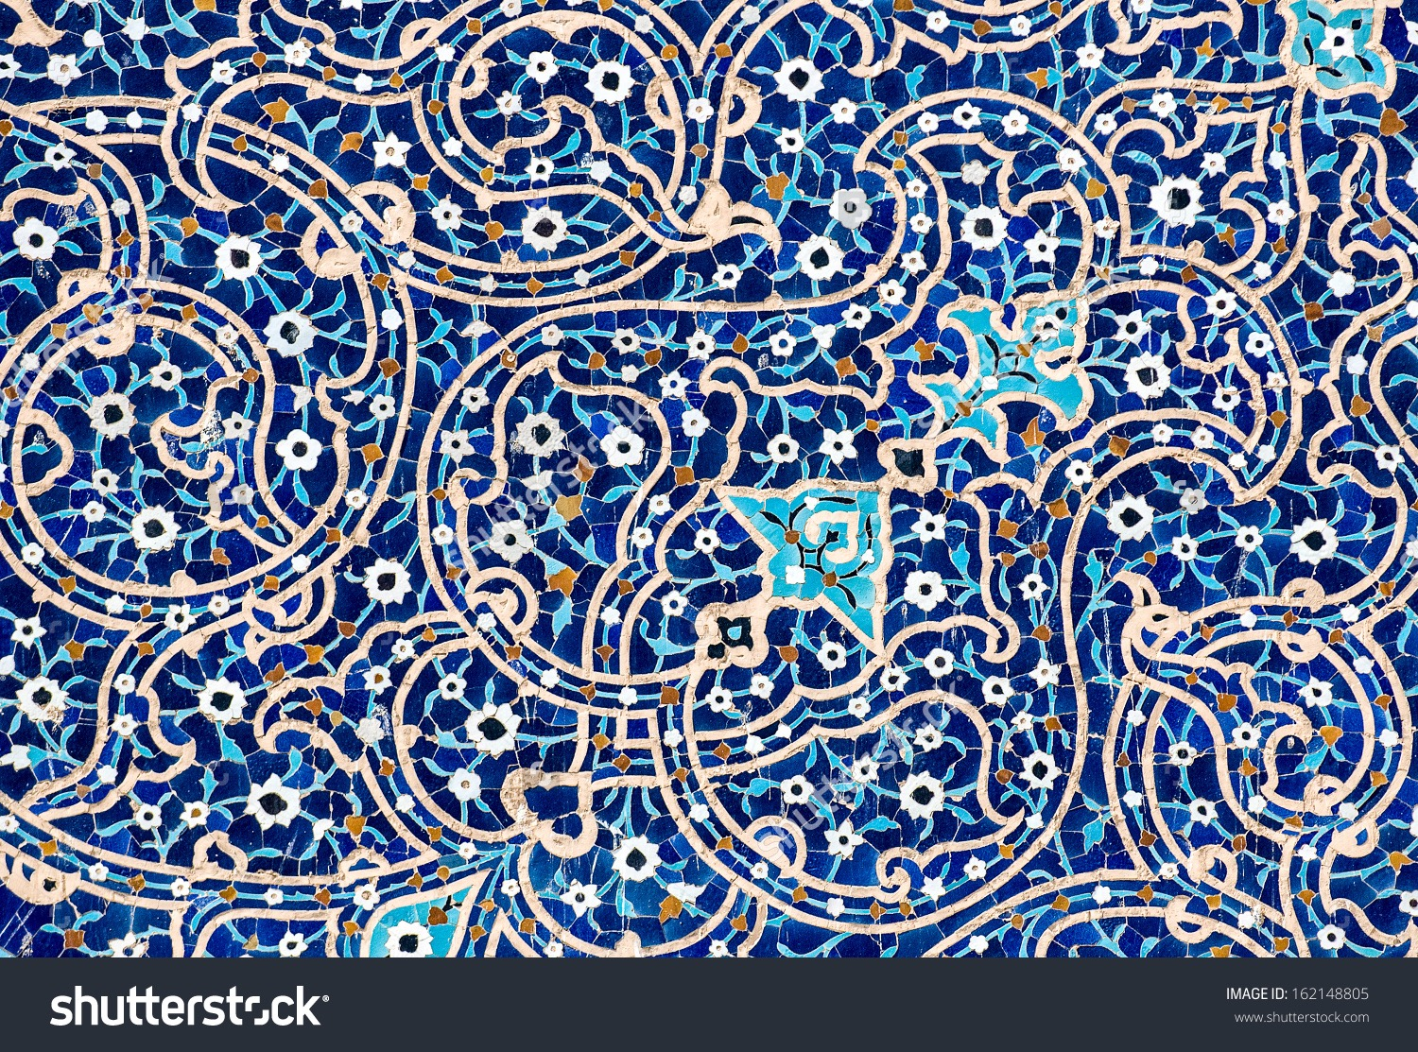
Law of Land
Roman Empire
Persian Empire
Any conquered land
was run independently
by satrap
Any conquered land
was forced to abide by
the central government
in Rome

Slide 13
COMMERCE

Slide 14
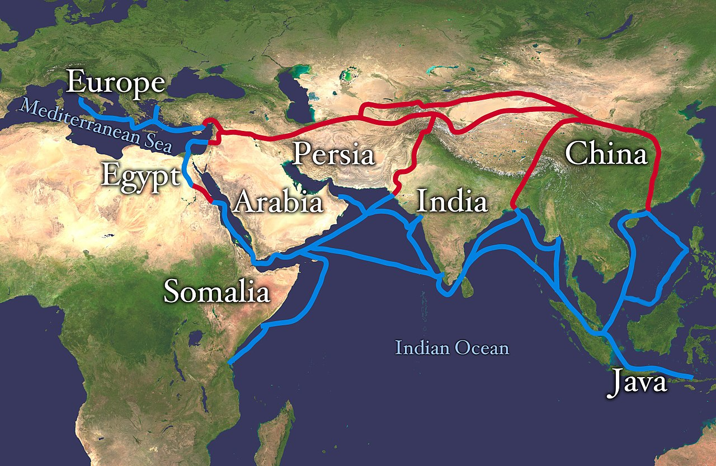
SILK ROUTES
2 BCE — 1800 CE
Notes:
SILK ROUTE: WAY OF COMMERCE —2BCE- 1800 CE

Slide 15

Languages
Latin
&
Parsi
Both Indo-European Languages
In Parsi, no difference in gender
One pronoun describes 3rd person singular,
and one 3rd person plural

Slide 16
Women’s Rights
“Women’s rights are human rights”
Amnesty International
—Persian women had the same rights as men
—Roman women had no rights

Slide 17
THE DREAM OF A BRIDGE BETWEEN EAST AND WEST

Slide 18
THEA MOUSA
A YOUNG SLAVE GIRL
FLEES A ROYAL ROMAN HOUSEHOLD
INTO A MYSTICAL,
HARROWING ADVENTURE.

Slide 19
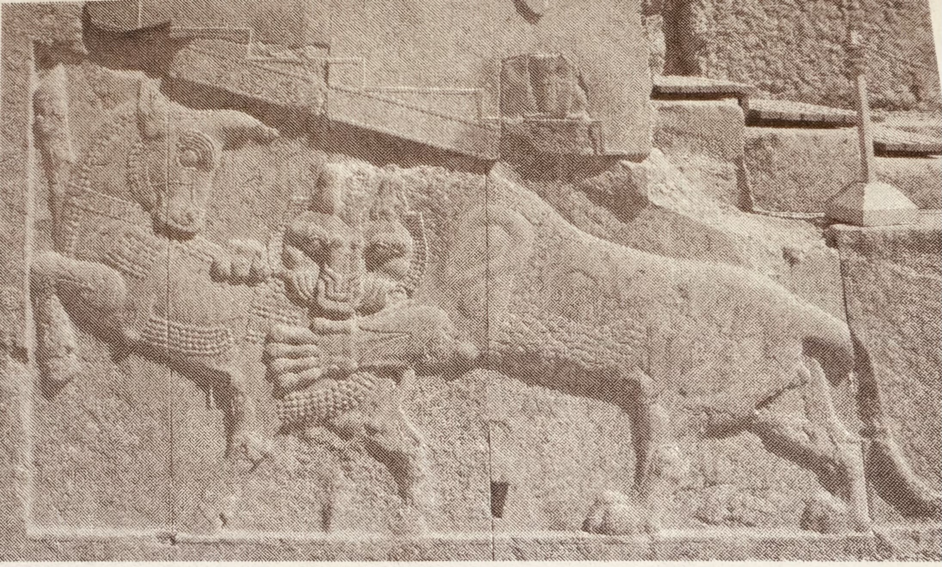
Architecture
Depiction of Persian Royal Power

Slide 20
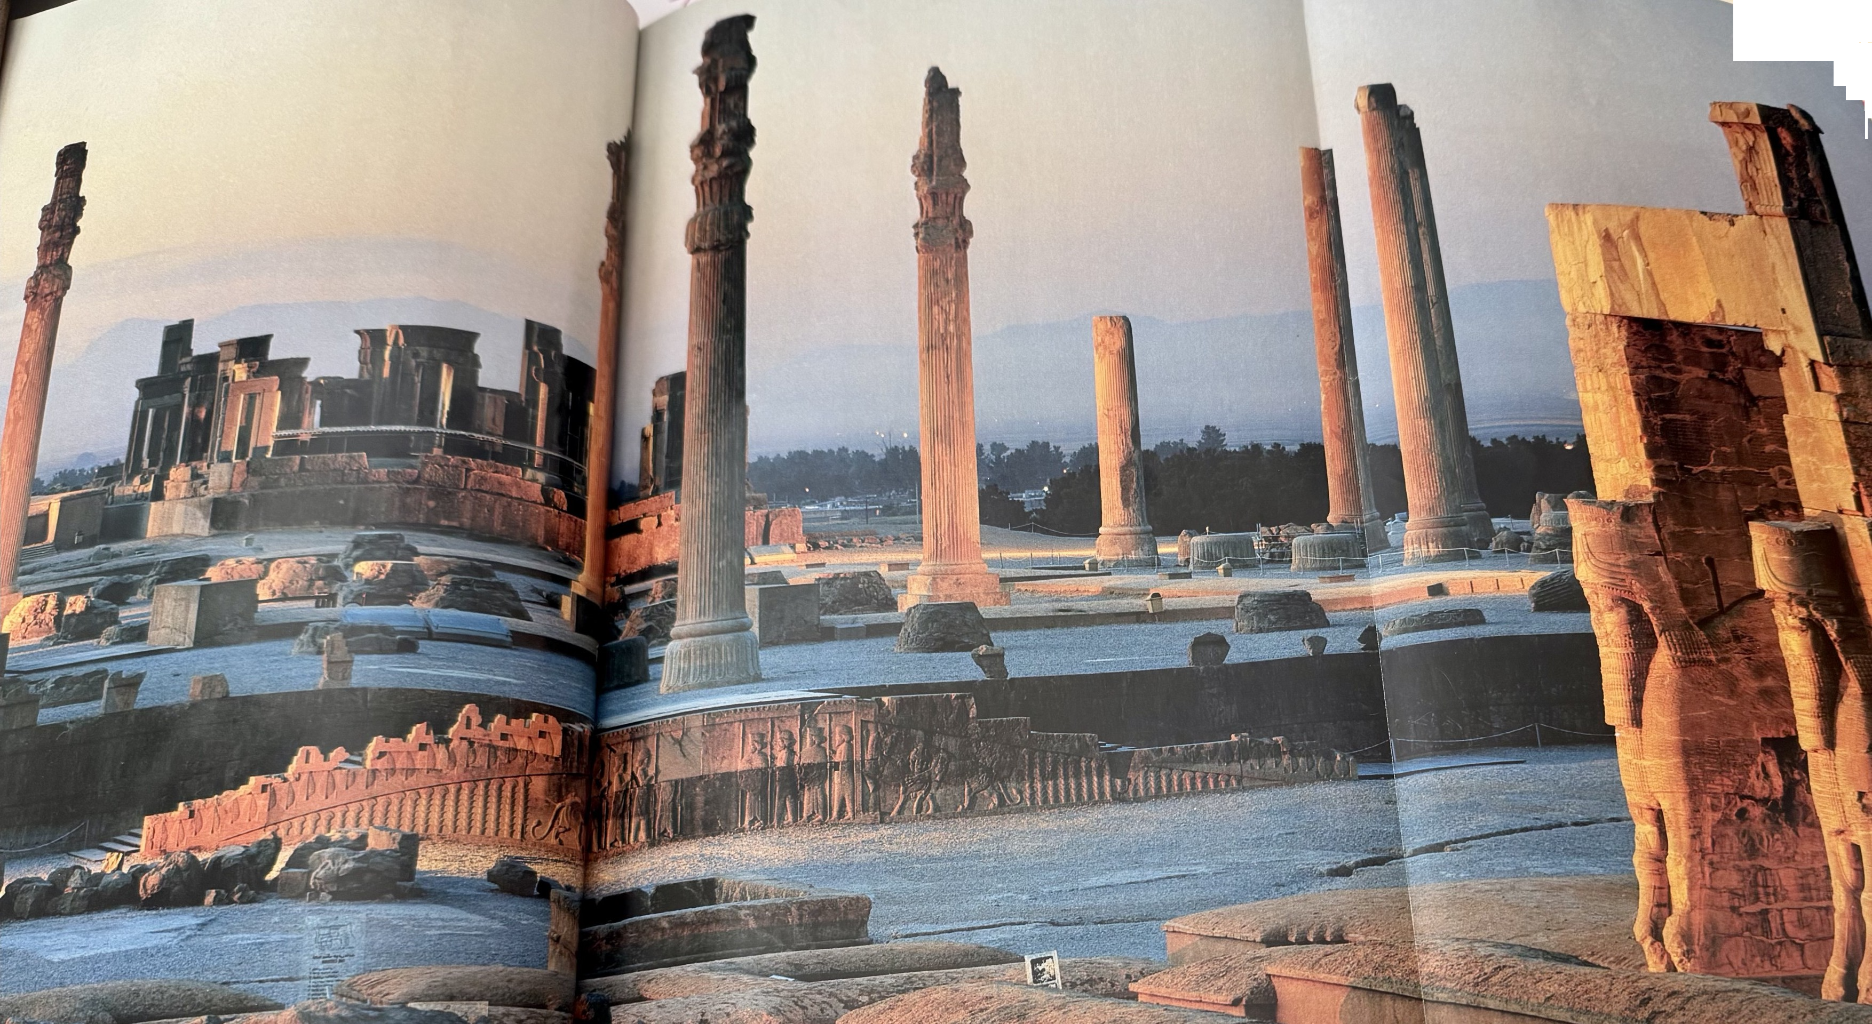
Persepolis

Slide 22
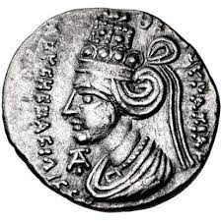
Thea Mousa
A ruling Queen of the
Parthian Empire
from 2BC to 4 AD

Slide 23


Slide 24
…the narrative like an every beating heart…
…great traveling through time, all the temporal and religious history…
…spiritual growth and overcoming obstacles in this life with bravery and kindness…
…Cyrus, the Great, is a new Beau Ideal for a ruler; it takes the strongest men and women to be gentle…
It is 1001 nights style, where wisdom
is conveyed with stories.

Slide 25

With no art,
the crudeness of reality
would make the world unbearable
Bernard Shaw

