Slide 1



Crisis as Moral Opportunity
Justice and Solidarity
Elena Álvarez-Álvarez
Faculty of Social Sciences and Humanities
Universidad Internacional de La Rioja

Slide 2
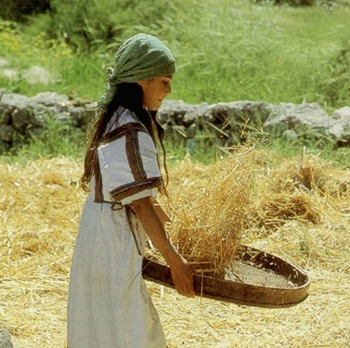
Some Notes about κρἷνω
'to separate, choose, select, decide, judge, condemn, accuse, apply’
κρίσις; 'decision, judgement, tribunal’
κριτήρ 'judge, examiner’
κριτήριον 'distinguishing mark, tribunal’
ὐπο-κρίνομαι 'to answer on stage (of the choir), to be an actor'

Slide 3
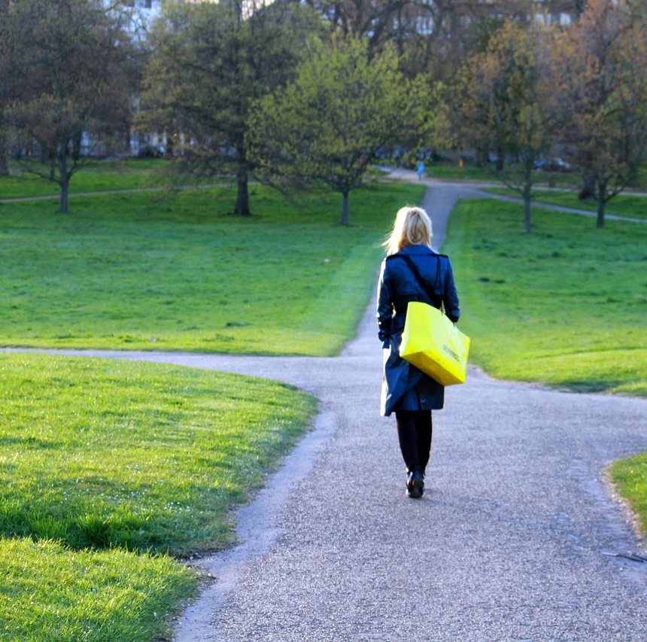
First remarks
‘Crisis’ is related to a moment of decision
Being at a crossroad - insecurity
This situation requires ‘critical sense’ – to assess, according to some criteria, to distinguish
There are people who act ‘like on a stage’ – lack of critical sense
https://pixabay.com/photos/girl-crossroads-choice-way-2573111/

Slide 4
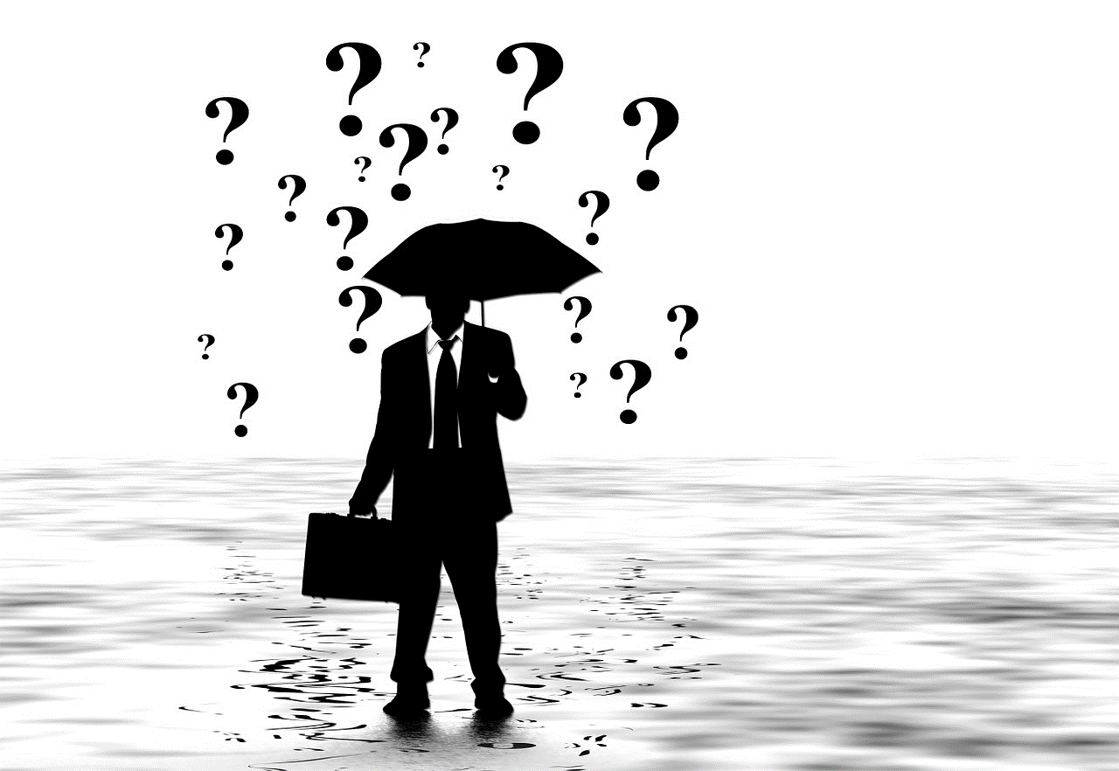
Our sense of ‘crisis’
Less related to ‘decision’, more related to the unavoidable
Related to economic processes (from 1929 – Great Depression)
Still seems a new beginning
Is here to stay: living in a changing world
https://pixabay.com/es/illustrations/hombre-silueta-malet%c3%adn-paraguas-96587//

Slide 5

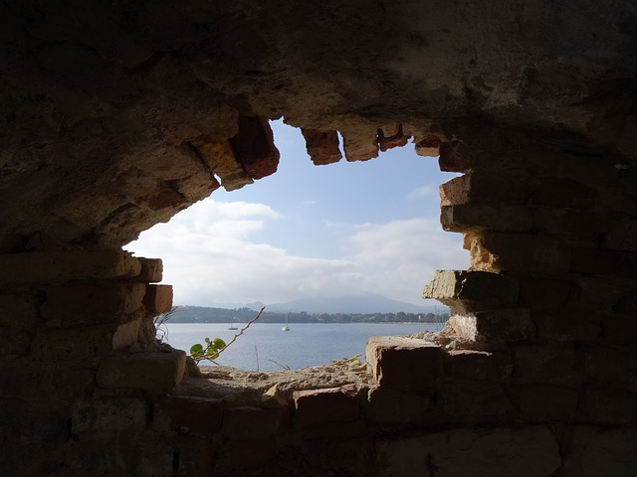
Crisis of culture? Or
Culture as crisis?
“A knife pressed against the future” (1976)
“A break in the wall” (1991; Kundera)
“Essentially revolutionary”
Essentially transgressive, because looking for a better world
Means to question even the apparently unquestionable – like the role of the stranger
Leads to the building of an autonomous society

Slide 6

The trouble
“The trouble with the contemporary condition of our modern civilization is that it stopped questioning itself. […] The price of silence is paid in the hard currency of human suffering. Asking the right questions makes, after all, all the difference between fate and destination, drifting and travelling. Questioning the ostensibly unquestionable premises of our way of life is arguably the most urgent of the services we owe our fellow humans and ourselves)”
(Bauman, Globalization, 1998, 5)

Slide 7
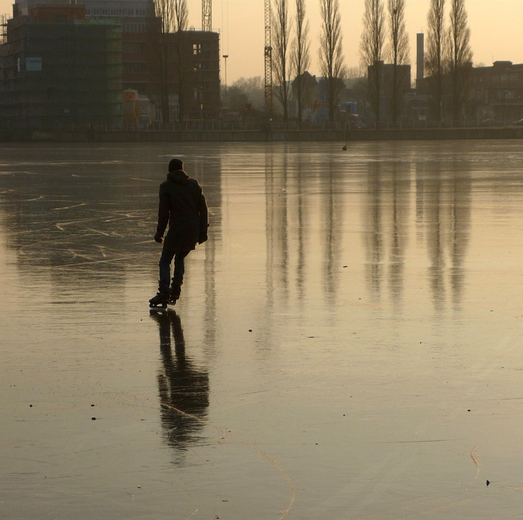
Facing a time of crisis
Times of important changes
Old systems eroded, no new structures to replace them
Living “like skating on thin ice”: safety is in speed (Bauman 2005)
Main problems of our time:
  “Divorce of power from politics”
  “TINA rule”
https://pixabay.com/photos/rummelsburg-bay-berlin-winter-ice-141028/

Slide 8

Uncertainty and Morality
Morality is free and, therefore, insecure
The erosion of old structures and systems gives back the decision to individuals
There are obstacles to morality:
  Indifference – denies the other in his / her humanity
  “Sensation seeker”
https://pixabay.com/es/illustrations/signo-de-interrogaci%c3%b3n-pregunta-mark-1722865/

Slide 9
On Contingency
“Western modernity is our contingency. Instead of destroying it, we could try to transform it into our destiny. This […]at heart it conveys a simple enough message. An individual has transformed his or her contingency into his or her destiny if this person has arrived at the consciousness of having made the best out of his or her practically infinite possibilities. A society has transformed its contingency into its destiny if the members of this society arrive at the awareness that they would prefer to live at no other place and at no other time than the here and now. And it is only modem society that can transform its contingency into its destiny, because it is only now that we have arrived at the consciousness of contingency”
(Heller, From hermeneutics in Social Science towards a Hermeneutic of Social Science 1989, 321)

Slide 10
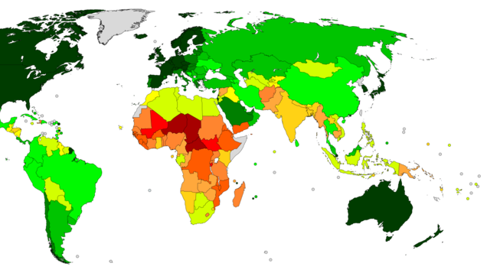
Moral questions
Time to make decisions
What to question: the consumerism at a global scale
Look to inequity, at a global scale – tourists and vagabonds
Main moral issue: indifference towards suffering – the metaphor of Thélème
https://es.m.wikipedia.org/wiki/Archivo:Countries_by_Human_Development_Index_(2020).png

Slide 11
What is Permanent?
Look for solidarity
Claim for moral responsibility of the citizens (different from consumers)
Solidarity as the social form of responsibility
Building of a new global order, with new agencies
https://pixabay.com/photos/rummelsburg-bay-berlin-winter-ice-141028/

