Slide 1

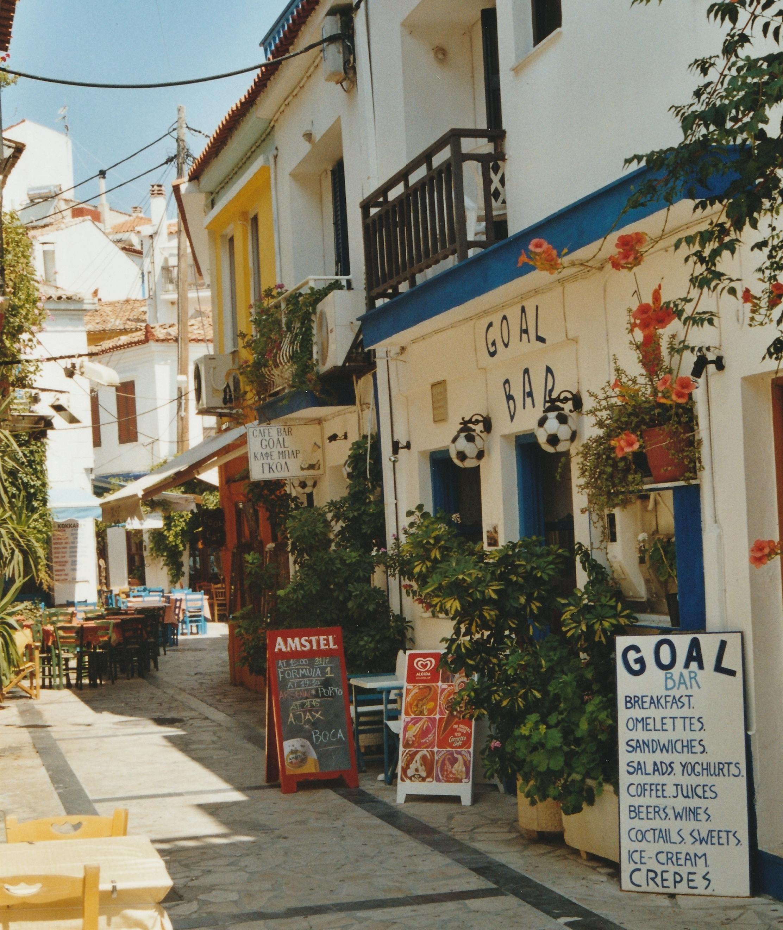
Greece Summer Program Week 3

Slide 2
Today’s Class
Checklist
Form Completion
Room Assignments
Brief Overview of Booklet
Introduce Jacob
Overview of Greece History and its’ Multicultural Society

Slide 3
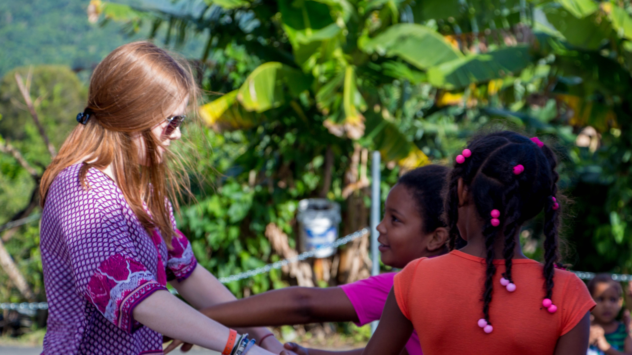
Cultural Understanding and Openness to a Transformative Experience

