Slide 1

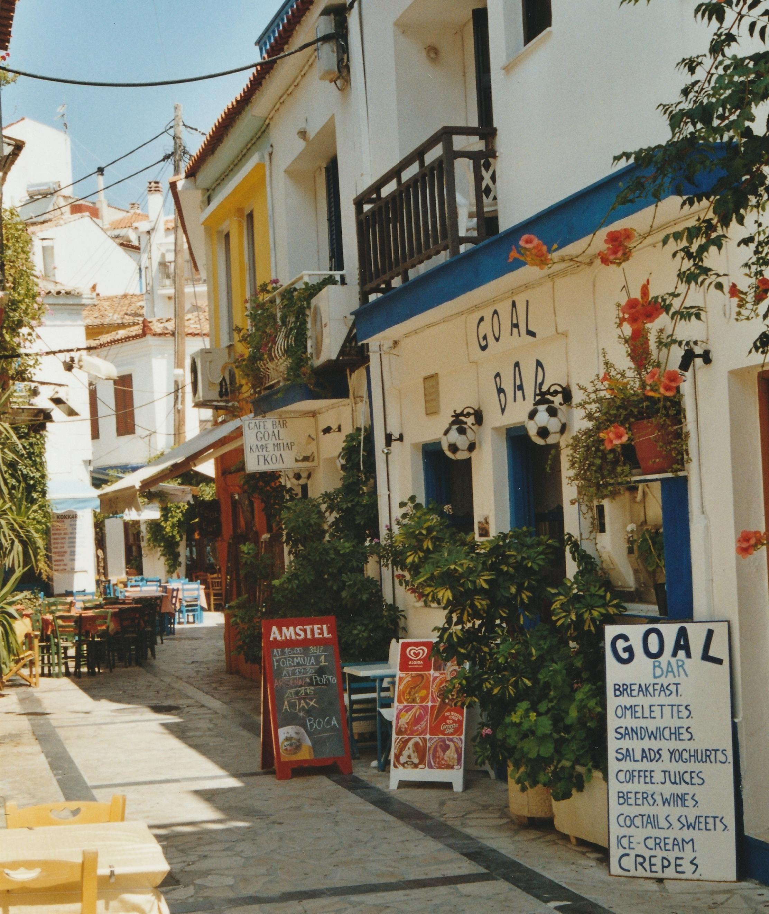
Greece Summer Program
Week 1

Slide 2
Today’s Class
Checklist
  Passport
  Airline Tickets
  Dietary Restriction Form
  Health and Safety Quiz
Class Assignments
Cover New Schedule (Slight change)
Diversity Conference Participation?
GroupMe?
Packing (luggage)
Weather-Olnancy

Slide 3
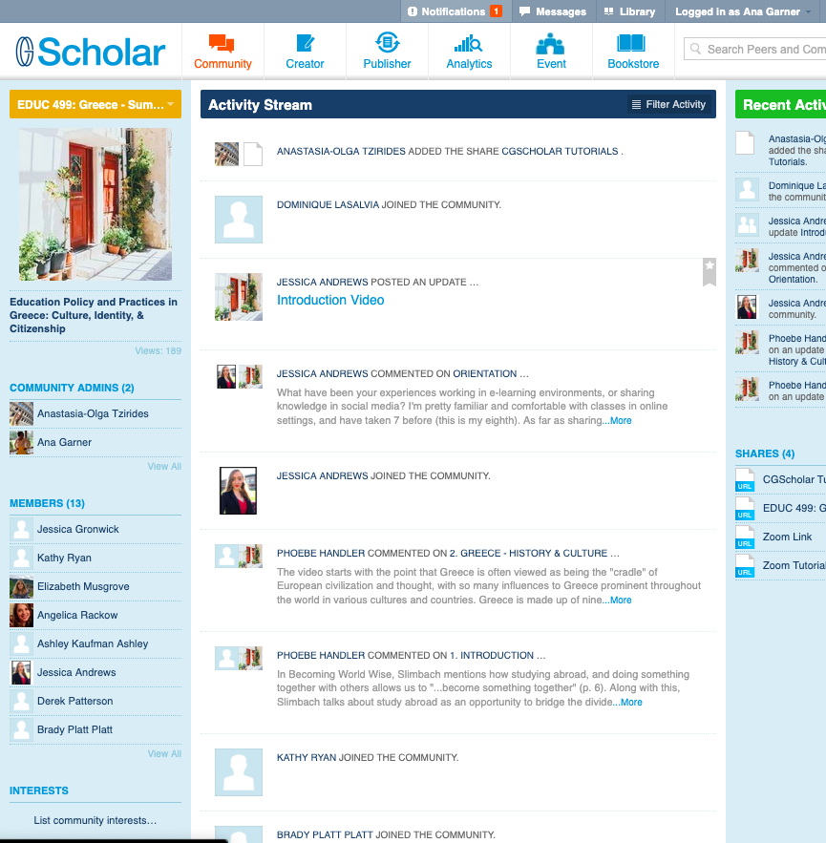
Scholar? What is that?
Did you register?
Olnancy

Slide 4
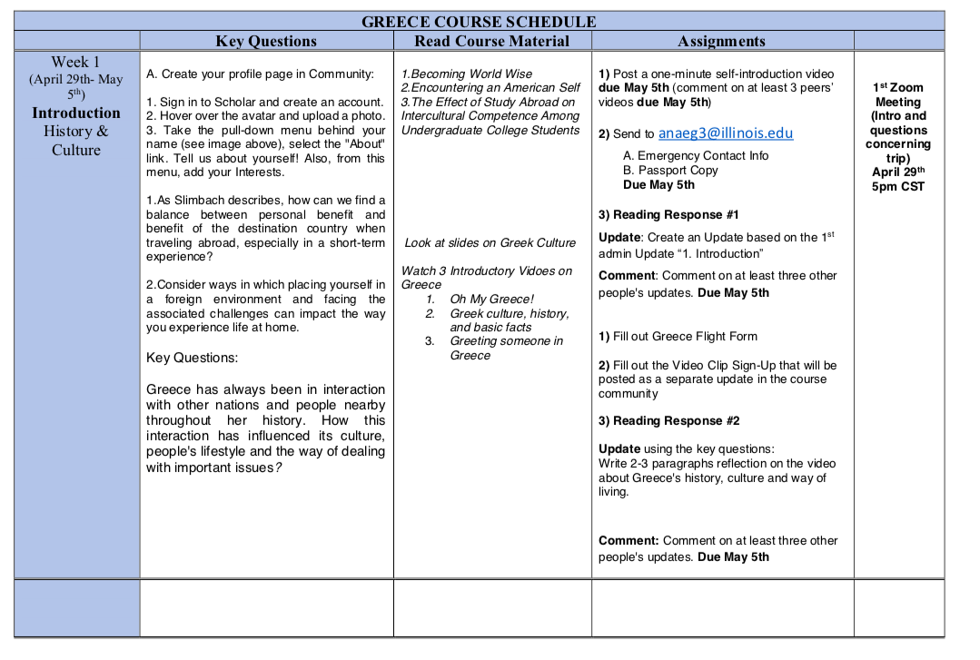

Slide 5
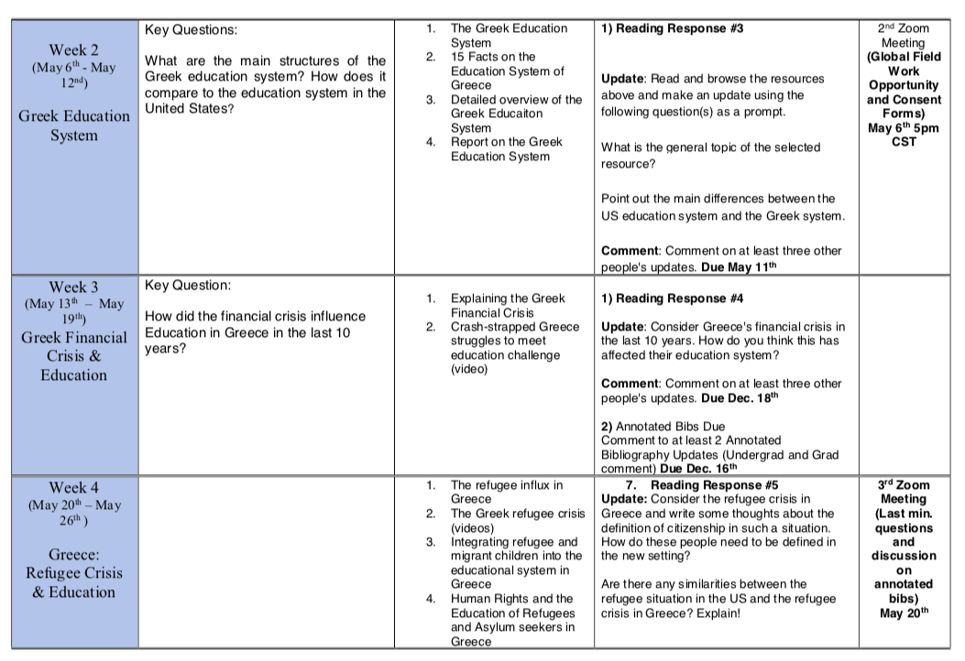

Slide 6
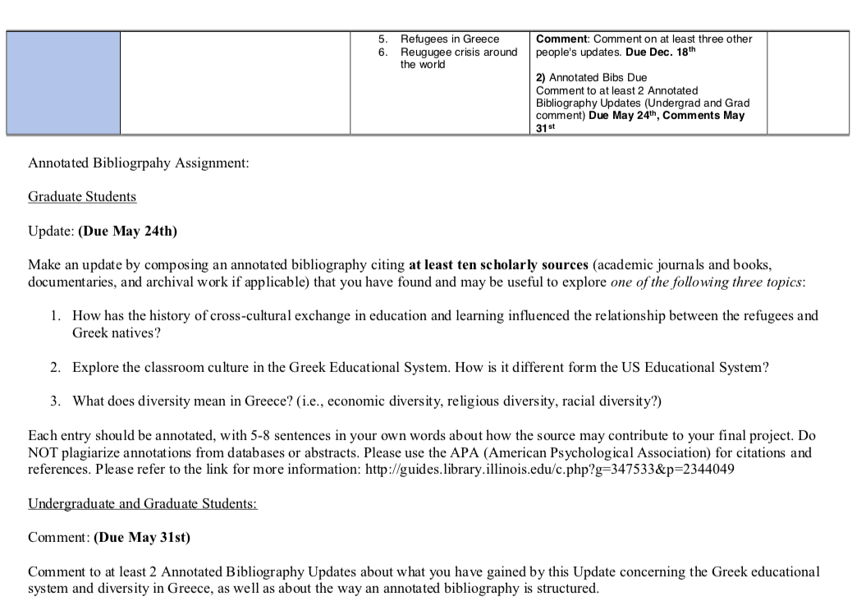

Slide 7
Saturday | Sunday | Monday | Tuesday | Wednesday | Thursday | Friday | Saturday | Sunday
6/1/19 | 6/2/19 | 6/3/19 | 6/4/19 | 6/5/19 | 6/6/19 | 6/7/19 | 6/8/19 | 6/9/19
 | Athens |  |  |  | Patras
Depart from the USA to Athens, Greece | Arrive in Athens Orientation City tour Tour of the Acropolis Group dinner with a view of the Acropolis | Lecture about the Greek education system Visit the archology and national museums Visit the American College of Greece and speak with students from the camp to campus program Leave for Patras | Day trip & Pre-conf event | Lecture on the Landscape of Greece city tour of Patras & visit the fortress Visit a school 45 Conf event Data collection | Participate in the 19th International Conference on Diversity in Organizations, Communities & Nations. The theme of the conference is Border Crossing Narratives: Learning from the Refugee Experience Group dinner | Data collection Conversation with locals about immigration and refugees in Greece or with Teachers Visit the Second Chance School and participate in an English lesson Free evening | Day trip: Visit Delphi and stop at small towns along the coast (Nafpaktos, Arachova, & Galaxidi) We will visit an ancient site, visit seaside towns, and stop at a beach. Stay at Mary’s | Visit Villiage Free afternoon or optional Beach excision about 30 minutes from Patras

Slide 8
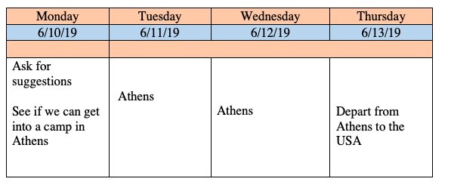

Slide 9

Will like the opportunity to present or participate in the conference?

